Slide 1



Practice
Constructing Interaction Graph
Digital Business Ecosystem Research Center

Slide 2
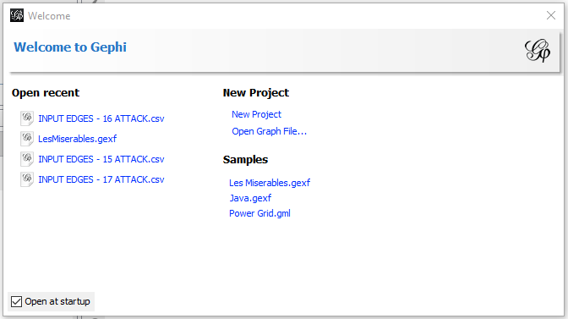

Open The Samples Data
Choose Les Miserables.gexf on Samples

Slide 3
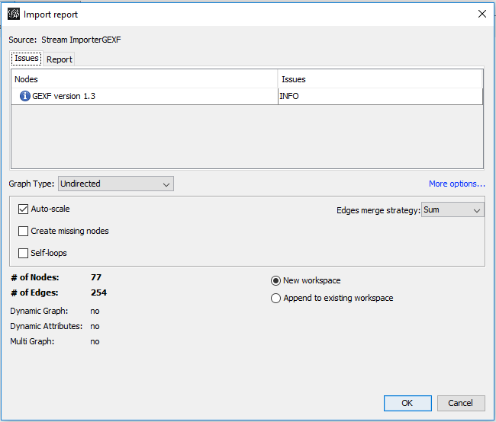
Data Information
Graph type can be undirected, directed, mixed
The workplace can be new or append to the existing one

Slide 4
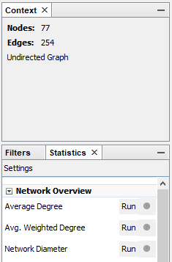

Run the Centrality Metric
Average Degree to measure Degree Centrality
Average Weighted Degree to measure Average Weighted Degree Centrality
Network Diameter to measure Betweenness Centrality and Degree Centrality
Eigenvector Centrality to measure Eigenvector Centrality

Slide 5
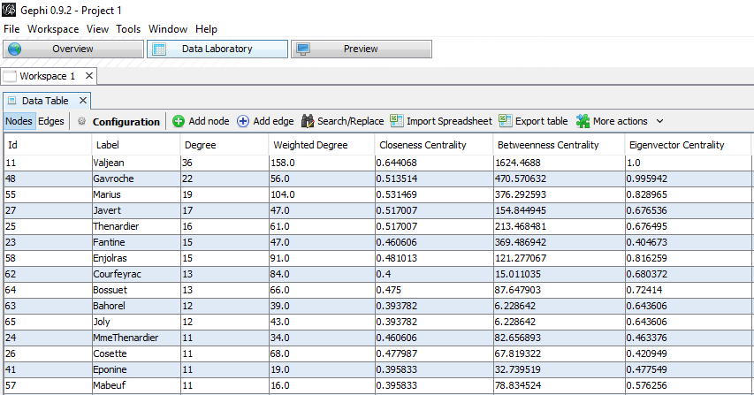
Centrality Metric Measurement Result

Slide 6
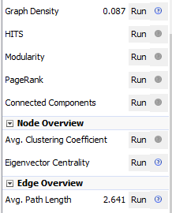
Run the Network Structure Metric
Graph Density to measure Network Density
Modularity to measure Community Detection
Connected components to measure Connected Components
Avg. Path Length to measure Average Path Length

Slide 7

THANK YOU

